Slide 1

Making carpooling easy and moving towards a sustainable city.
A carpool driver’s best friend.

Slide 2
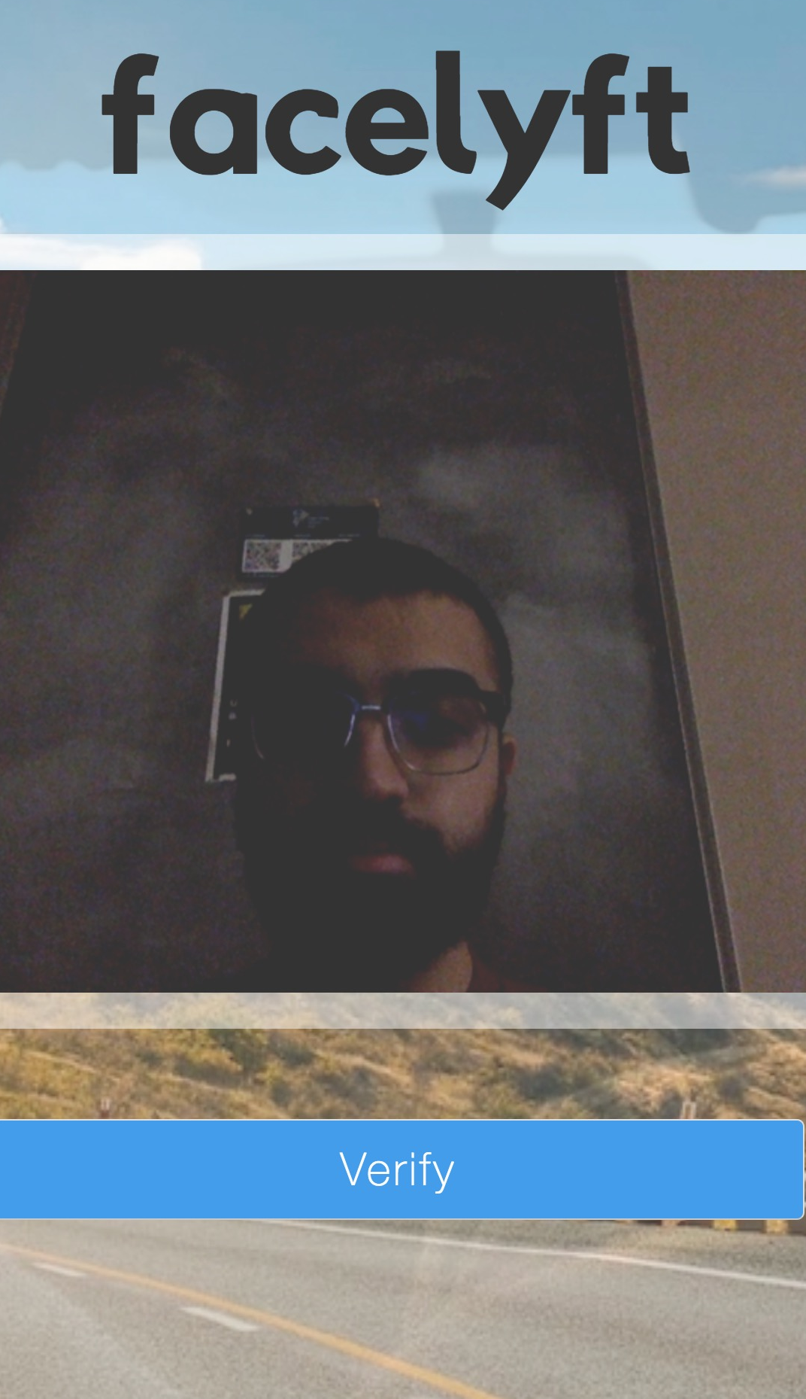
APPLICATION OF FACELYFT
Effortless Login
Secure System
Quick Transactions
Ease of Use

Slide 3

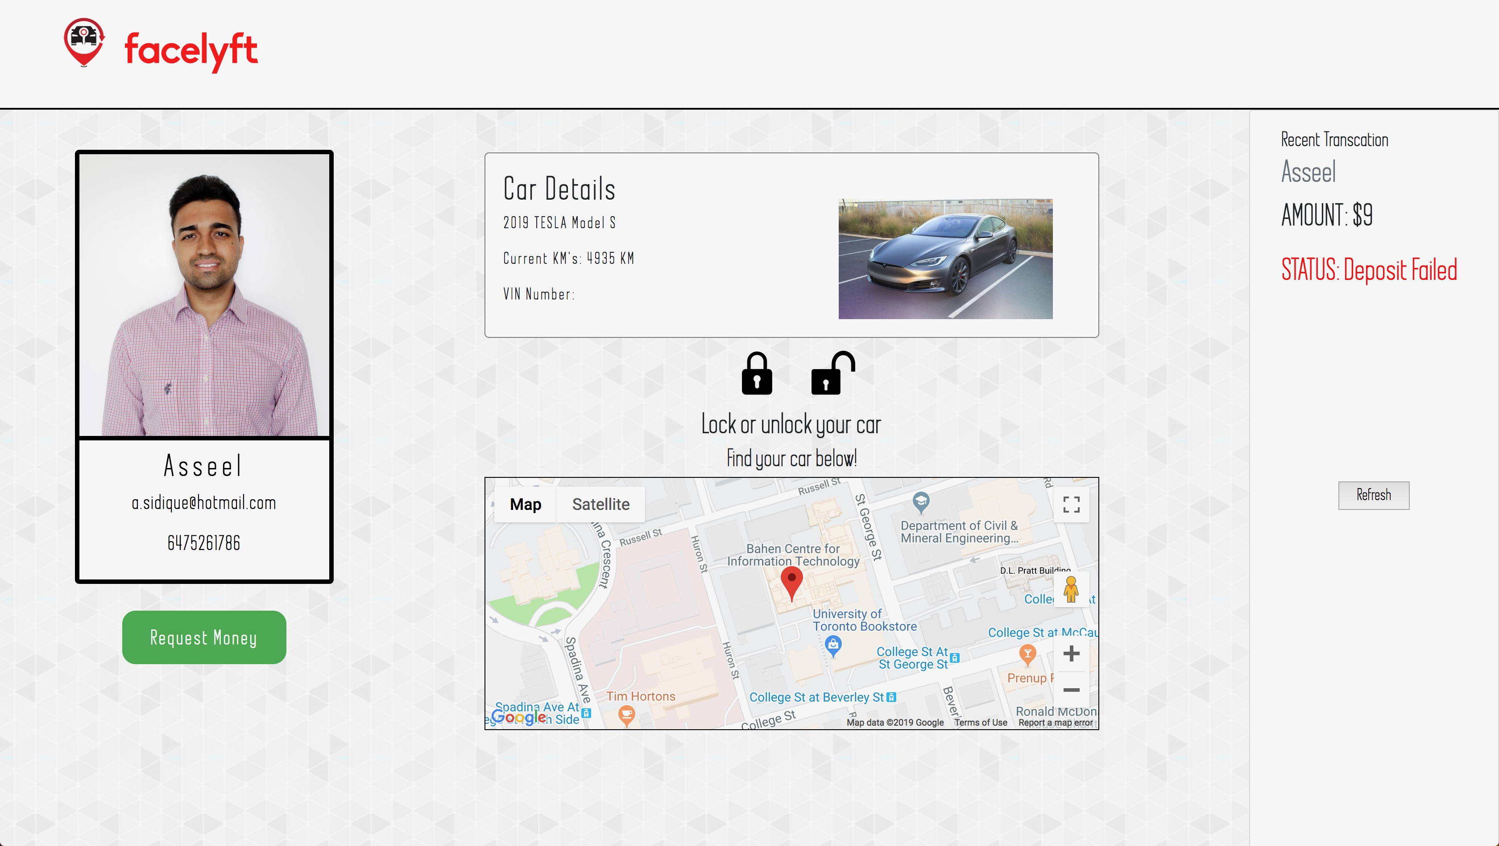
FACELYFT LAYOUT

Slide 4


LOCK OR UNLOCK YOUR CAR
STEP 1:
TAKE A PHOTO OF YOURSELF TO VERIFY YOUR ACCOUNT.
Creative
STEP 3:
YOUR CAR WILL BE LOCKED OR UNLOCKED.
Technical
Strategic
STEP 2:
CLICK ON THE LOCK OR UNLOCK BUTTON.
eCommerce
Lock or unlock car

Slide 5
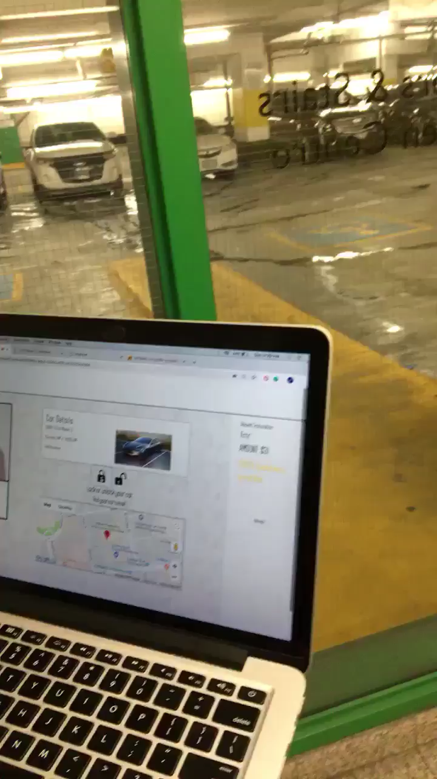
VIDEO DEMO: UNLOCK/LOCK YOUR CAR

Slide 6
REQUEST MONEY FROM RIDERS
STEP 1:
TAKE A PHOTO OF A RIDER.
STEP 3:
THE RIDER CAN SEND THE PAYMENT WAS WAS REQUESTED THROUGH E-TRANSFER.
INTERAC E-TRANSFER Greg sent you a request for money.
STEP 2:
THE RIDER RECEIVES A REQUEST FOR PAYMENT.
Received

Slide 7
FUTURE OUTLOOK
Expanding our facial recognition database.
Further incorporating the SmartCar API to enrich driver experience.
Using our custom built security API for a number of other applications.

Slide 9



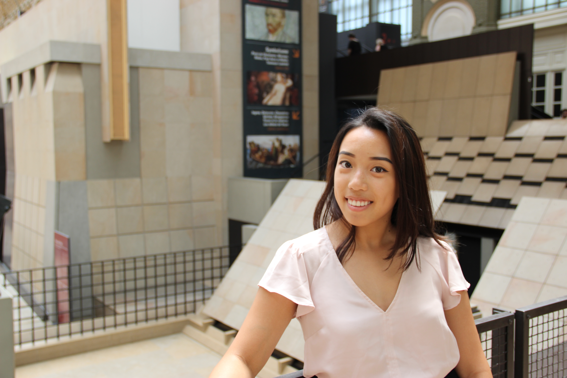

OUR TEAM
Asseel Sidique
API Developer & Front-End Integration
Kyra Stephen
Machine Learning and AI Expert
Amr Mahmoud
Systems & Integration Engineer
Lisa Tran
UI/UX Designer

